Slide 1
Intro to Networking: OSI Model – Physical and Data Link Layer
Christian Silva
Regina Plummer
Alonzo Singleton
David Lee
Khilna Rawal

Slide 2
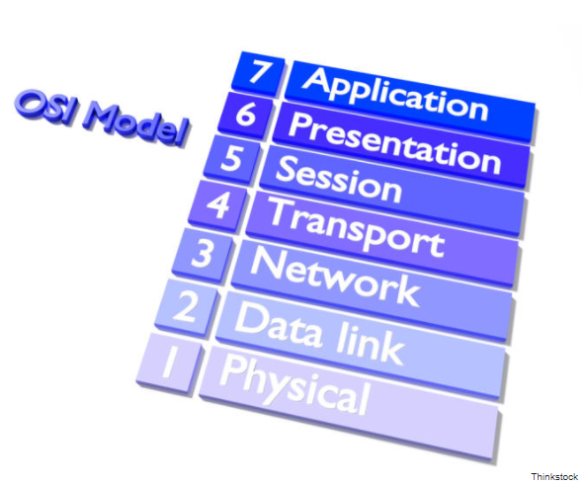
Open Systems Interconnection (OSI) Model
TECHNOLOGY STANDARD SINCE 1984
Notes:
Model of how network protocols and equipment should communication and work together. Was ratified by the International Standards Organization in 1984.

Slide 3
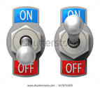
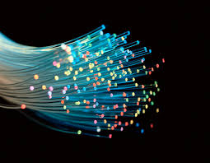
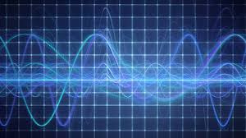
Level 1: Physical Layer – The Electrical and Physical Representation
The Electrical Representation can also be represented by radio waves and light pulses
Electrical Voltage
Radio Frequencies
Fiber Optics
Notes:
Level 1 is responsible for the transmission and reception of the digital data bits from the sending source and to the receiving device. The Physical Layer transmits the data using electric voltage, radio frequencies or pulses of light. In addition to the data encoding of the binary data, the physical layer also determines and communicates to the receiving station the "bit-time" start and the frame delimiter.

Slide 4
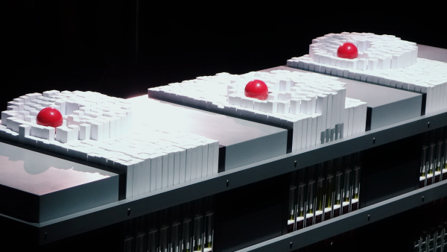
Tangible technology
Notes:
HERE ARE THE PHYSICAL LAYERS OF THE OSI MODEL
HUBS & REPEATERS ARE STANDARD NETWORK DEVICES THAT FUNCTION AT THE PHYSICAL LAYERS THEY ARE THE CHEAPEST WAY TO CONNECT TWO OR MORE COMPUTERS TOGETHER.
ROUTERS BASICALLY CONNECTS NETWORKS EITHER WIRED OR WIRELESS CONNECTIONS
ETHERNET CONNECTS DEVICES TOGETHER WITHIN A LOCAL AREA NETWORK LIKE PCS YOU CAN USE THEM FOR GAMMING AND ETC

Slide 5
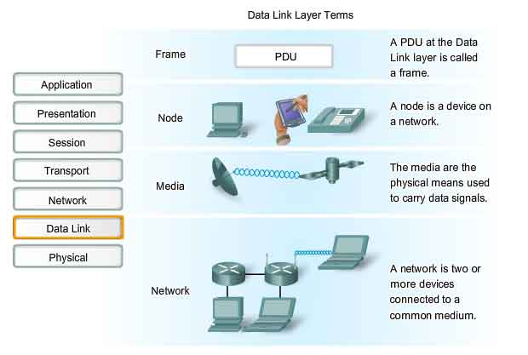
Data link layer
Notes:
This layer is the protocol layer that transfers data between adjacent network nodes in a wide area network (WAN) or between nodes on the same local area network (LAN) segment. The data link layer provides the functional and procedural means to transfer data between network entities and might provide the means to detect and possibly correct errors that may occur in the physical layer.

Slide 6

Sublayer: Logical Link layer
Notes:
The Logical Link Control (LCL) layer is one of two sublayers of the Data-Link layer in the Open Systems Interconnection (OSI) model of communication. The LCL layer is concerned with managing traffic (flow and error control) over the physical medium. The LCL layer also identifies a line protocol, such as SDLC, NetBIOS, or NetWare, and may also assign sequence numbers to frames and track acknowledgements.

Slide 7
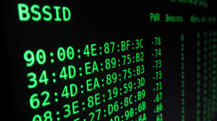
SUBLayer: Media access control (MAC)
Notes:
One of the two sublayers of the Data Link Control Layer in which it is concerned with “sharing the physical connection to the network among several computers. Each computer has its own unique MAC address.”
Provides addressing and channel access. This allows for terminals or network nodes to communicate to a network.
Acts as an interference between the logical link control (LLC) Ethernet sublayer and Layer 1 (the physical layer).
Used to direct pakets from one device to another, as data is traveling over a network.

Slide 8
SOURCES:
Mitchell, B. (2018, February 2). The layers of the OSI model illustrated . Lifewire. Retrieved from https://www.lifewire.com/osi-model-reference-guide-816289
The OSI model's seven layers defined and functions explained. (n.d.) Microsoft Support. Retrieved from https://support.microsoft.com/en-us/help/103884/the-osi-model-s-seven-layers-defined-and-functions-explained
Shaw, K. (2017, December 17) The OSI model explained: how to understand (and remember) the 7 layer network model. Network World from IDG. Retrieved from https://www.networkworld.com/article/3239677/lan-wan/the-osi-model-explained-how-to-understand-and-remember-the-7-layer-network-model.html
Rouse, M. (n.d.). What is Media Access Control layer (MAC layer)? - Definition from WhatIs.com. Retrieved February 14, 2018, from http://searchnetworking.techtarget.com/definition/Media-Access-Control-layer
Rouse, M. (n.d.). What is Logical Link Control layer (LCL layer)? - Definition from WhatIs.com. Retrieved February 14, 2018, from http://searchnetworking.techtarget.com/definition/Logical-Link-Control-layer
TechLibrary. (n.d.). Retrieved February 14, 2018, from https://www.juniper.net/documentation/en_US/junos/topics/concept/mac-qfx-series-understanding.html

